Slide 1
CSC230
Hashing Tables

Slide 2
How to find stuff?
Array:
Given an index value
Retrieve the corresponding item
0 | 1 | 2 | 3 | 4 | 5 | 6 | 7
2.1 | 3.4 | 5.6 | 1.2 | 8.0 | 9.2 | 2.2 | 5.4
1.2
key
Value
…
Map/Dictionary:
Given an key value k
Return associated map[k] value
The Shawshank redemption | 1994
The Godfather | 1972
The Godfather: Part II | 1974
The Dark Knight | 2008
Pulp Fiction | 1994

Slide 3

How to organize the data of Map/dictionary ?
Array?
Entries are ordered by Key values
In worst case, after (log n) comparisons, we will find the entries.
Entries are not ordered
On average, need to compare n/2 entries
In worst case, need to compare n entries
Linked list?
Entries are ordered by key values
In worst case, needs n comparisons
On average, needs n/2 comparisons
Entries are not ordered
In worst case, needs n comparisons
On average, needs n/2 comparisons

Slide 4
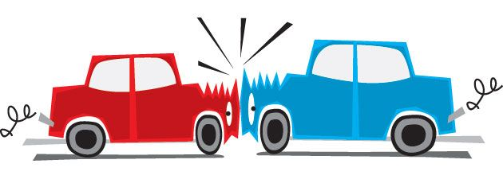
Hashing
Idea:
Save items in a key-indexed table (index is a function of the key)
Hash Function:
Computing array index from the key
0
1
2
3
4
5
6
7
8
life
is
good
!
but
isn’t
cafe
hash("is") = 1
hash("but") = 5
hash("this") = 5
Issues with Hash Function:
Time complexity: trivial
Space complexity: trivial
Collision: two different keys mapped to the same index
Need Algorithms and data structure to handle it

Slide 5
Hash Function
Goals: scramble the keys uniformly
Each index is equally likely for each key
Time complexity is low
Ex. Phone number:
First three digits.
Last three digits.
How about the middle three
digits?
Ex. Social Security Number:
✗
609 = trenton area, 732 = central NJ
✔
SSN Area Number | Location
001-003 | New Hampshire
004-007 | Maine
008-009 | Vermont
010-034 | Massachusetts
035-039 | Rhode Island
040-049 | Connecticut
050-134 | New York
135-158 | New Jersey
159-211 | Pennsylvania

Slide 6
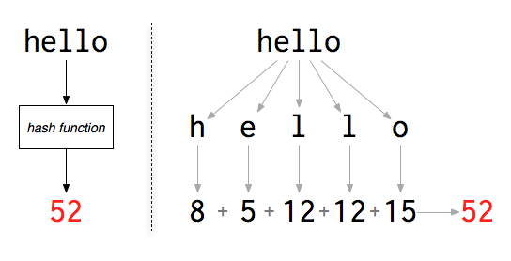
Hash Function
A Hash Function scrambles the keys uniformly
Map the key value to an integer
The integer is in the range of [0, tableSize - 1]
Usually, hash function is provided by user
Ex. Strings
Keeping hash(k) within the range of table size
hash(k) % tableSize

Slide 7
Table Size ?
Ideal Situation:
Each pair of (key, value) has its own entry
Example: New Jersey Vehicle Plates: AZY 55M, CCA T23 would require how many table entries?
At least 36⁶
Not all the plate numbers used
We often need a (small) subset of keys
Practical Situation:
Table size is larger than the expected entries
If it is smaller than the number of key values, COLLISION
Make the table size be Prime number
More discussion later

Slide 8
How to resolve collision ?
Table Size < the number of Key Values:
According to pigeonhole principle, collision is unavoidable
Table Size >= the number of Key Values:
If hash function is well designed, no collision
otherwise, COLLISION
Phone number example: first three digits, last three digits
Make the table size be Prime number
It may reduce collision chance
More discussion later

Slide 9
Buckets/chains
Each entry of the array is an ARRAY (bucket) or a LINKED LIST (chain)
Buckets
What is the array size?
Too much wasted space
Chaining
Each entry is a linked list
Key, value
0
1
2
3
4
5
tableSize -1
Key, value
0
1
2
3
4
5
tableSize -1

Slide 10
Collision resolution: open addressing/closed hashing
Open addressing. [Amdahl-Boehme-Rocherster-Samuel, IBM 1953]
・When a new key collides, find alternate location in the array, and put it there
Linear probing
The Interval between probes is fixed – often at 1
Quadratic probing
The interval between probes increases linearly
Double hashing
The interval between probes is fixed, calculated by another hash function

Slide 11
Linear probing
Key, value
Primary clustering
Certain data patterns lead to many collisions, linear probing leads to clusters of occupied areas in the array
0
1
2
3
4
5
6
7
8
occupied
occupied
occupied
occupied
occupied
…

Slide 12
Quadratic probing
Key, value
Primary clustering
Quadratic probing takes larger and larger steps, which tends to spread out the data across the array
0
1
2
3
4
5
6
7
8
occupied
occupied
occupied
occupied
occupied
…

Slide 13
How to find/remove?
Given linear or quadratic clustering, how to find a (key, value) pair?
Hash the key
If the (key, value) pair is not at hash(key), search linearly or quadratically
Find it or
An empty location or
Search the whole array
How to remove the pair ?
First find the pair in the array
Mark the location as “removed”. You must use a special thing to label it; otherwise, the insertion will be messed up, why?

Slide 14
Double hashing
Two hashing functions, h₁(k) maps key k to an array location, h₂(k) is the interval between probes
First check h₁(k)
If occupied, then check h₁(k) + h₂(k)
If occupied, then check h₁(k) + 2*h₂(k)
If occupied, then check h₁(k) + 3*h₂(k)

Slide 15
Hash Function
An ideal hash function should map each given key to a unique location in the table
Practically, it is unattainable most of the times
A “good” hash function
Simple and fast
Scramble data evenly across the array
Scatter random keys evenly
Table size is 5, keys = [0..14], h(k) = k % 5 does not scatter data randomly
Scatter clustered keys evenly
Rules of thumb
Hash function should use the whole key, not a portion of it
Whenever use modulo hashing, the base should be prime number

Slide 16
Modulo Arithmetic
Simple hash function can be h(k) = k mod m
If m is NOT a prime. Let m be 10^{d} or 2^{d}
The keys clustered in the lower order digits will cause collisions
For example,
h(k) = k mod 100, k is the birth year

Slide 17
Table size should be prime, why ?
Assume a set of numbers K = {k₁, k₂, k₃, … }
They all have the same hash result, which is k_{i} mod 10^{d}
For example, 99, 199, 299, 4399
If tableSize is prime, and we use k mod tableSize to hash
What is the chance these numbers hash to the same locations?

Slide 18
Table size should be prime, why ?
If k₁ and k₂ hash to the same value and table size is 10^{d} we have
k₁ mod 10^{d} = k₂ mod 10^{d} = r (same remainder)
We have k₁ = x * 10^{d} + r, k₂ = y * 10^{d} + r,
Thus, k₁ - k₂ = (x -y) * 10^{d}
In other words, all the keys k₁ - k₂ equals to some multiple of 10^{d} hash to the same value, collision!
For example, 199 -99 = 100, 299 -99 = 200, 4399 – 299 = 4200

Slide 19
Module hashing
If the table size is a prime number p instead of 10^{d} , the hash function map the key to “k mod p”.
If k₁ and k₂ were to map to the same place, k₁ - k₂ (we know is a power of 10^{d} ) would also have to be divisible by p
If k₁ and k₂ to map to the same place, k₁ - k₂ would be some multiple p * 10^{d}
For example, if p = 13 and d =2, k₁- k₂ would have to be 1200, 2600, 3900

Slide 20

Hash Function
When we build hash table, hash function usually has two steps
First, convert the original data to a new value, which should be scattered (not clustered)
For example, JAVA use the following function to calculate the hash code for a given string, please note prime number 31 is carefully selected.
Once the new value is calculated, use a prime number to do module operation, convert it to an index value of array.

